Slide 1
NAME – ANANYA GUPTA CLASS – 9TH(B) ROLL NO. – 3 SUBJECT – S.ST SCHOOL - DELHI PUBLIC SCHOOL KATRA

Slide 2
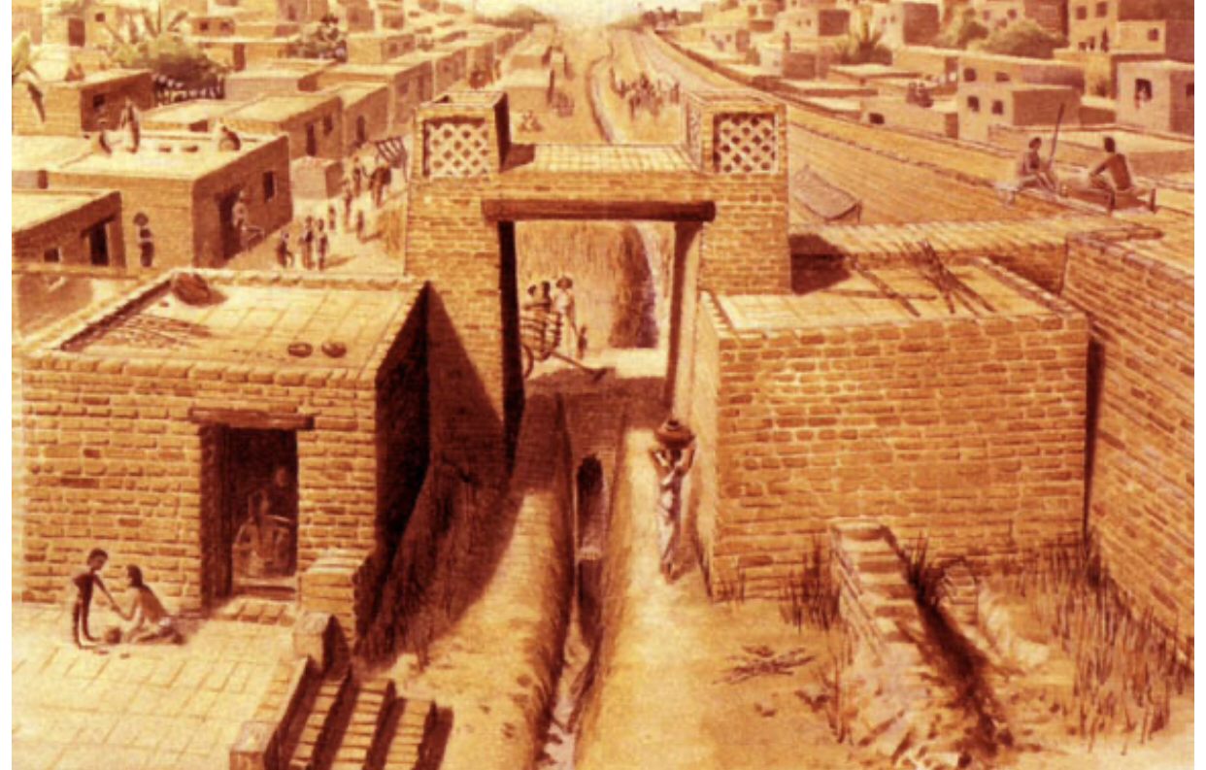
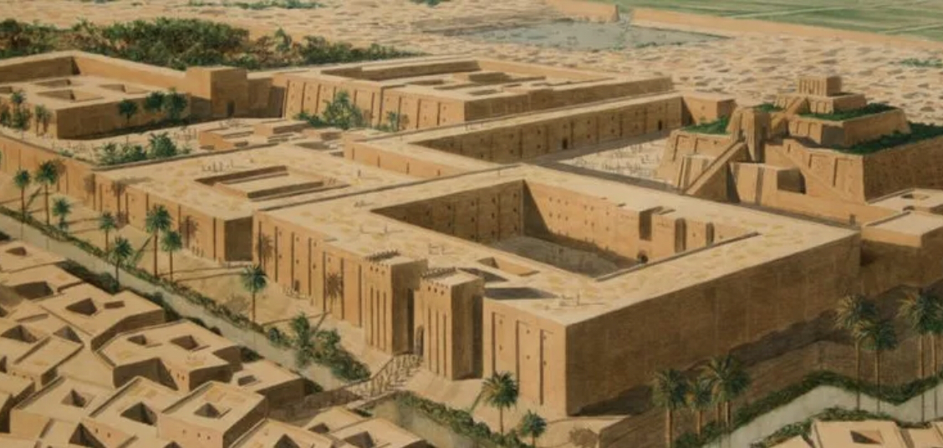
COMPARATIVE STUDY OF HARAPPAN AND MESOPOTAMIAN CIVILISATION

Slide 3
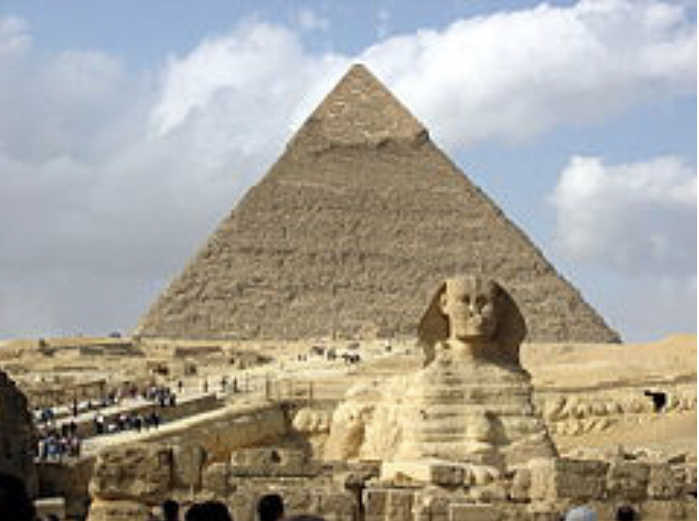
CIVILISATION
Civilisation comes from the Latin word ‘civis’ meaning – someone who lives in a town .
A civilisation is a human society that exists in a particular time and place , with a complex organisation which includes political , economic and social and cultural elements and their organisation make each civilisation unique .

Slide 4
INTRODUCTION OF HARAPPAN CIVILISATION
Harappan civilisation is one of the most ancient civilisation of the world .
Harappan civilisation is also known as Indus Valley civilisation .
This civilisation is flourished around 4000– 1000 BC .
Harappan and Mohenjo-daro were important centers of harappan civilisation .

Slide 5
INTRODUCTION OF MESOPOTAMIAN CIVILISATION
Mesopotamian is the Greek word for the land between the rivers . It was the valleys of Tigris and the Euphrates that the first civilisation begin . The first to develop an urban civilisation in Mesopotamian were the sumerians , who colonised the marshlands of the lower Euphrates , which together with the Tigris , flows into the Persian gulf . However their culture endured . Akkadians , babylonians , Elamites , and other adapted to Sumerian religion legal , literary and art form .

Slide 6
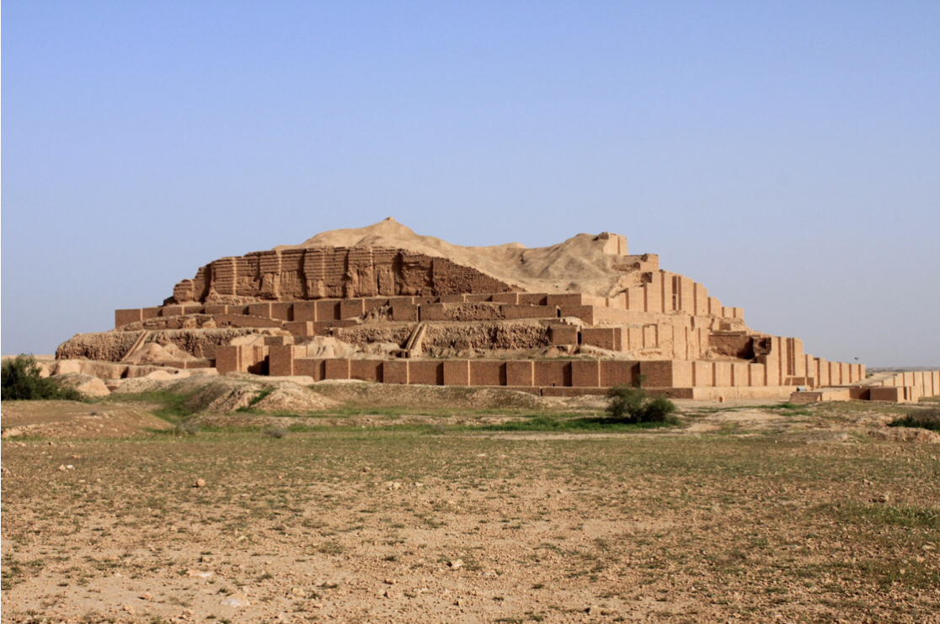
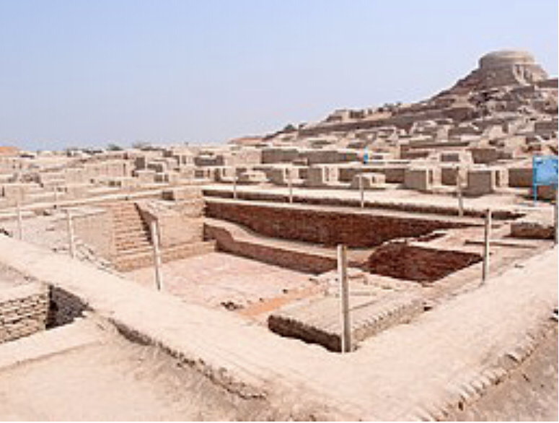
COMPARATIVE STUDY OF ARCHITECTURE
MESOPOTAMIAN CIVILISATION
HARAPPAN CIVILISATION
The Harappan city was divided into two or more part .
The part to the west was smaller , however higher part known to be as a citadel .
The part to the east was partially larger but lower and called as ‘the lower town’ .
People built one or two story houses .
The Harappan city had a well-planned drainage system .
In Mesopotamia , the houses was made by sun-dried bricks, because there was little wood and stone .
Ziggurats were built by the ancient Sumerians , Babylonians , Akkadians for local region .
The roofs were flat , so that it was like a fourth flour .
Buildings raised on huge platforms due to torrential rains and frequent flood .
Bitumen , pitch , mortar of calcareous earth used as cementing material .

Slide 7
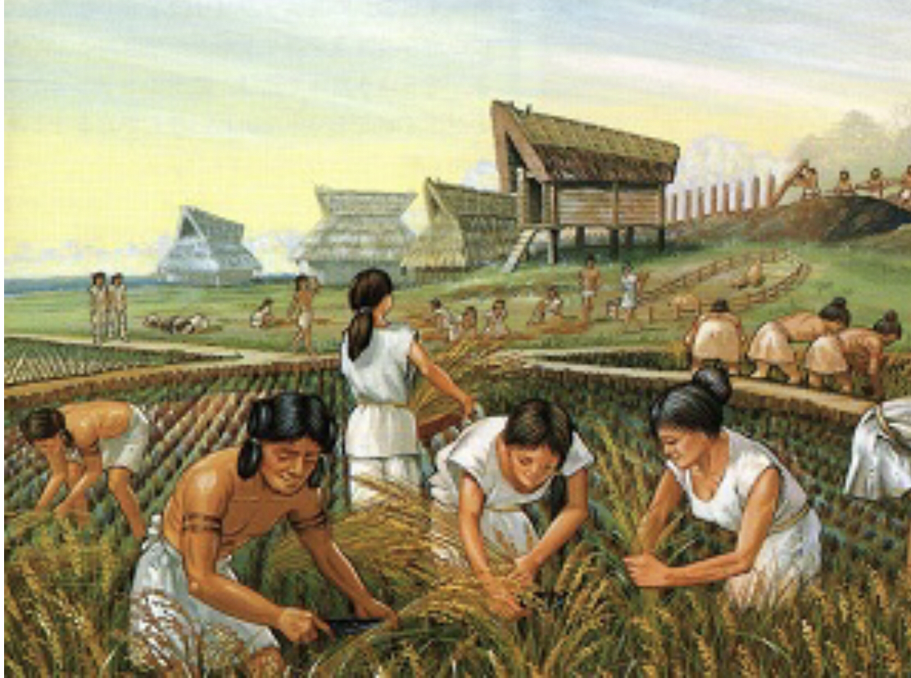
COMPARATIVE STUDY OF AGRICULTURE AND FARMING
MESOPOTAMIAN CIVILISATION
HARAPPAN CIVILISATION
Harappans grew wheat , barley , pulses , rice and mustard .
They also developed some tools known as plough used to dig for planting the seeds and turning the soil .
A method of irrigation was used due to less rainfall .
The Harappan reared cattle Sheep , goat and buffaloes.
People of Mohenjo-daro , Harappa and Lothal also had a huge storehouse used for storing grains and were called granaries .
Agriculture was the main economic activity in ancient Mesopotamia.
They focused above all on the cultivation of cereals and sheep farming .
They also farmed legumes , as well as date palms in the south and grapes in the north .
There are two types of Mesopotamian agriculture :- (1.) The agriculture of southern or lower Mesopotamia . (2.) The agriculture of northern or upper Mesopotamia .
This civilisation grew along two rivers .

Slide 8
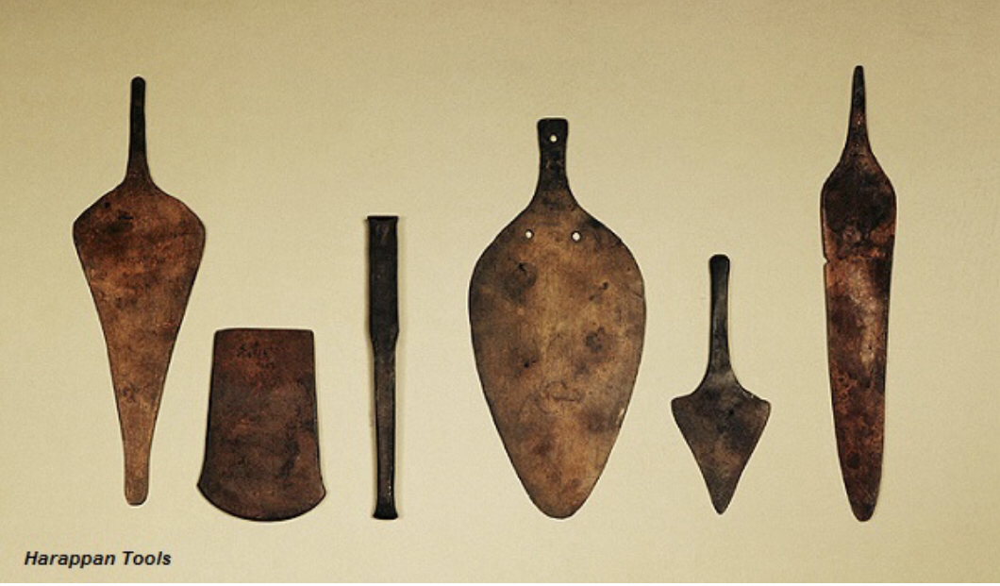
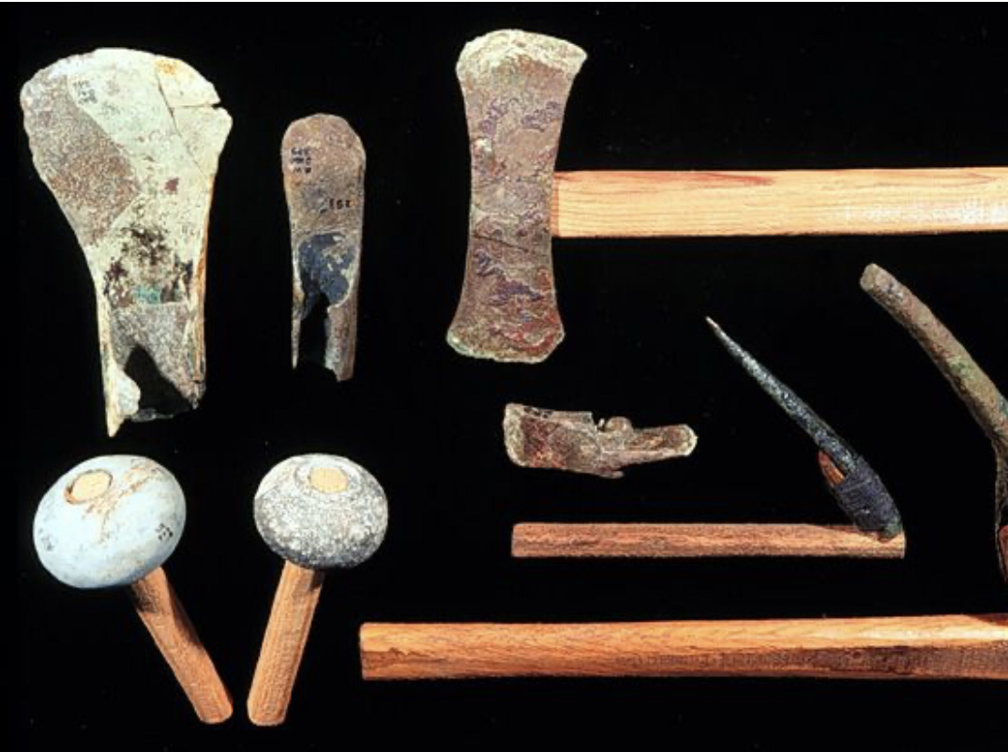
COMPARATIVE STUDY OF TOOLS AND WEAPONS
HARAPPAN CIVILISATION
MESOPOTAMIAN CIVILISATION
Tools and weapons were simple in form
They comprised flat-axes , arrowhead , knives , saws , and fish-hook .
People also made copper and bronze vessels .
They made small plates and continued to use knives of chert blades .
The weapons in ancient Mesopotamians were highly used by soldiers.
Soldiers used equipment for their wars .They use slings to kill when conscripted into the military.
They use spears , axes , bows and arrows .
To protect themselves , these foot soldiers would have body armour, round helmet , and small round shields .

Slide 9
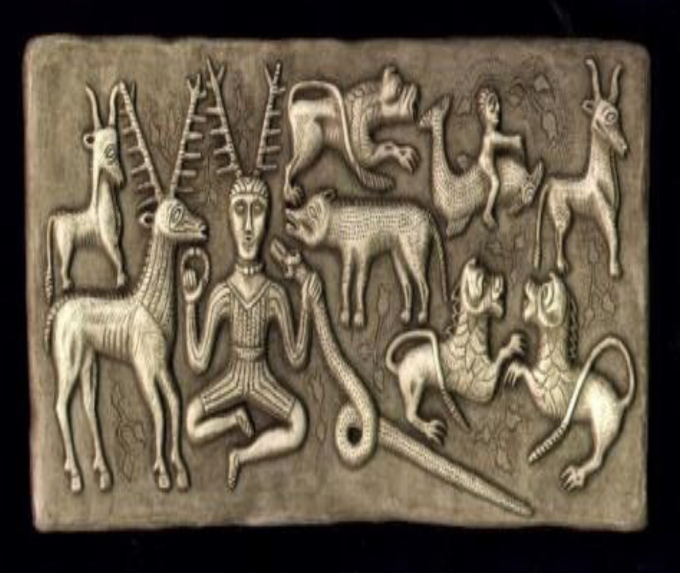
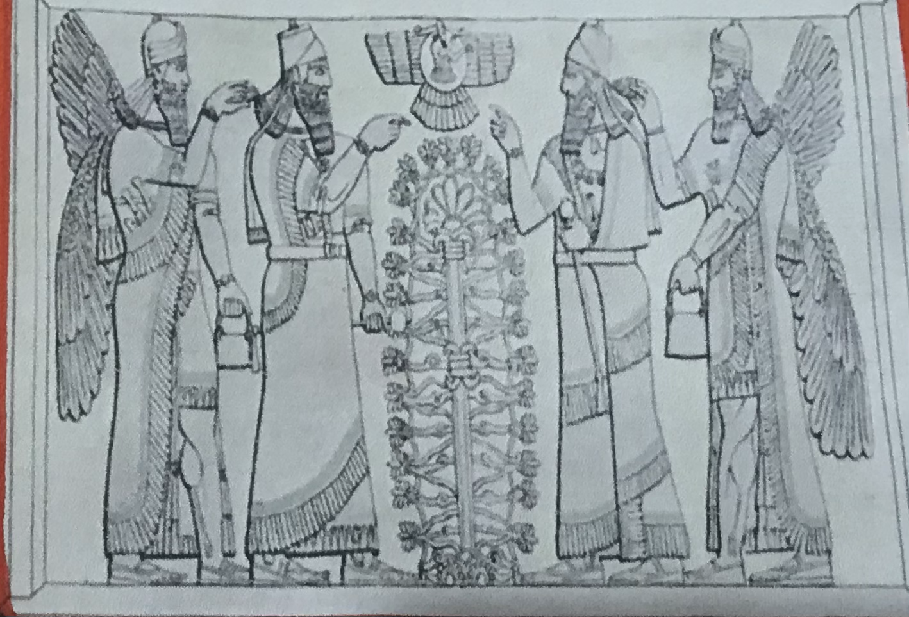
COMPARATIVE STUDY OF RELIGION
HARAPPAN CIVILISATION
MESOPOTAMIAN CIVILISATION
The Harappan civilisation religion is polytheistic and is made up of Hinduism , Buddhism , Jainism .
There are many seals to support the evidence of the Harappan civilisation .
Some seals show animals which resemble the two gods , Shiva and Rudra .
The Harappan people worshipped a father God who may have been the forefather of the race .
They may believed in magic rituals , charms and amulets and also demons and spirits .
Mesopotamian religion refers to the religious beliefs and practices .
Akkad , Assyria , Babylonia between circa 3500BC and 400AD , after which they largely gave way to Syriac Christianity .
In early Mesopotamian , priests were the initial rulers as all authority came from the God .
Mesopotamia’s pantheon of gods and their deeds make up the region rich .
Mesopotamian religion finally declined after the spread of Iranians religion

Slide 10
THE DECLINE OF THE CIVILISATION
HARAPPAN CIVILISATION
MESOPOTAMIAN CIVILISATION
The reasons for the decline of Harappan civilisation are:–
Mohenjo-daro excavations reveal that the city was destroyed over and over again and was rebuilt at the same site nine times. This had a weakening effect on the civilisation.
Floods , natural calamities , or epidemics could have contributed to the decline.
Changes in the course of the river Indus, which left the land dry and infertile played a role in the decline of the civilisation.
Foreign invasions took its roll in weakening the civilisation.
The reasons for the decline of Mesopotamian civilisation are:-
The rivers were higher than the surrounding plains because of built – up silt in river beds .
Water for irrigation flowed into the fields by gravity.
Historians also opine that the wars were an important cause for the decline.
Invasion of hittites which marked the end of old Babylonian empire in Mesopotamia during 1900 BC to 1600BC .

Slide 11


